Slide 1

Department of Computer Engineering
(NBA Accredited)
Academic Year 2023-24
CSL605 SKILL BASED LAB COURSE: CLOUD COMPUTING
Townhall Project
under the guidance of
prof. DEEPALI KAYANDE

Slide 2
TEAM MEMBERS
ATHARV VINAY AGHARKAR
NIRAJ ANANT BADE
LALIT YOGINATH BAGUL

Slide 3
PROBLEM DEFINITION
The project aims to deploy the "Townhall" website onto the Amazon Web Services (AWS) platform using Elastic Beanstalk and establish a connection with an Amazon Relational Database Service (RDS) instance. As integrating Elastic Beanstalk with RDS will enable seamless execution of CRUD (Create, Read, Update, Delete) operations, empowering the "Townhall" website to efficiently manage user interactions, store user-generated content, and maintain data integrity within the cloud environment.

Slide 4
OBJECTIVES
Cloud Deployment: The project focuses on deploying the "Townhall" website onto Amazon Web Services (AWS) cloud platform using Elastic Beanstalk.
Database Integration: It involves integrating Amazon Relational Database Service (Amazon RDS) to store user data, feedback submissions, and ratings securely.
Seamless User Experience: The integrated cloud architecture ensures smooth user interactions, quick response times, and uninterrupted access to the "Townhall" website, enhancing the overall user experience.
Cost-Effective Solution: Leveraging AWS's pay-as-you-go pricing model, the project optimizes costs by only paying for the resources consumed, making it a cost-effective solution for hosting and managing the "Townhall" website.

Slide 5
FEATURES / FUNCTIONALITY
AWS:
Scalability: AWS ensures your website can easily handle varying traffic levels.
Reliability: Enjoy high availability and fault tolerance for uninterrupted website access.
Security: Benefit from robust encryption and access management to safeguard your data.
Flexibility: Customize your infrastructure and applications with a wide range of AWS services.
Cost-Effectiveness: Optimize costs with AWS's pay-as-you-go pricing model.
Website :
Serves as a platform for users to engage in various community-driven activities such as
Exploring various active clubs of the college.
Finding details of each clubs.
Participating in interested clubs by registering.
Submitting feedbacks.
Rating various clubs as per user’s experience.

Slide 6
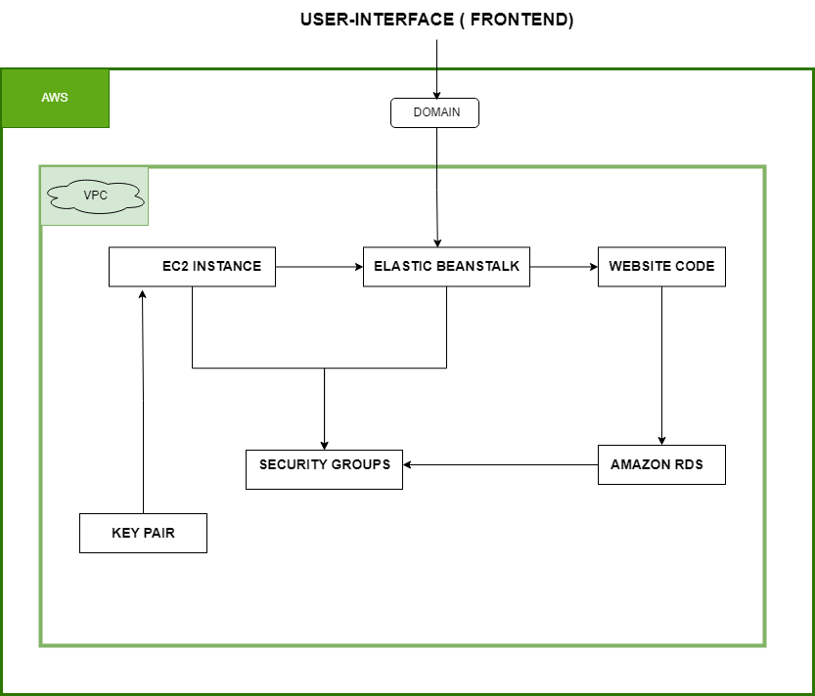
ARCHITECTURE DIAGRAM

Slide 7
TECHNOLOGY STACK
Front-End :
HTML/HTML5
CSS ( Bootstrap )
JavaScript
Back-End :
PHP
Database : MySql
Deployment and Hosting:
AWS Elastic Beanstalk : Platform as a Service (PaaS)
Amazon RDS : Configured to MySQL and connected by importing website’s db schema.
Development tools :
Visual Studio Code

Slide 8
REFERENCES
Amazon Web Services (AWS) Documentation.
Elastic Beanstalk Developer Guide.
Amazon RDS User Guide.

Slide 9
THANK YOU!

